Slide 1
Topics to cover
Probability
Supervised learning
Unsupervised learning
Classification problems where naïve bayes algorithm is applied

Slide 2
Supervised Learning
Supervised learning, also known as supervised machine learning, is a subcategory of machine learning and artificial intelligence. It is defined by its use of labeled datasets to train algorithms that to classify data or predict outcomes accurately. As input data is fed into the model, it adjusts its weights through a reinforcement learning process, which ensures that the model has been fitted appropriately. Supervised learning helps organizations solve for a variety of real-world problems at scale, such as classifying spam in a separate folder from your inbox.

Slide 3
Classification uses an algorithm to accurately assign test data into specific categories. It recognizes specific entities within the dataset and attempts to draw some conclusions on how those entities should be labeled or defined. Common classification algorithms are linear classifiers, support vector machines (SVM), decision trees, k-nearest neighbor, and random forest, which are described in more detail below.
Regression is used to understand the relationship between dependent and independent variables. It is commonly used to make projections, such as for sales revenue for a given business. Linear regression, logistical regression, and polynomial regression are popular regression algorithms.

Slide 4
Examples
Supervised learning models can be used to build and advance a number of business applications, including the following:
Image- and object-recognition: Supervised learning algorithms can be used to locate, isolate, and categorize objects out of videos or images, making them useful when applied to various computer vision techniques and imagery analysis.
Predictive analytics: A widespread use case for supervised learning models is in creating predictive analytics systems to provide deep insights into various business data points. This allows enterprises to anticipate certain results based on a given output variable, helping business leaders justify decisions or pivot for the benefit of the organization.
Customer sentiment analysis: Using supervised machine learning algorithms, organizations can extract and classify important pieces of information from large volumes of data—including context, emotion, and intent—with very little human intervention. This can be incredibly useful when gaining a better understanding of customer interactions and can be used to improve brand engagement efforts.
Spam detection: Spam detection is another example of a supervised learning model. Using supervised classification algorithms, organizations can train databases to recognize patterns or anomalies in new data to organize spam and non-spam-related correspondences effectively.

Slide 5
UNSupervised Learning
Unsupervised learning uses unlabeled data. From that data, it discovers patterns that help solve for clustering or association problems. This is particularly useful when subject matter experts are unsure of common properties within a data set. Common clustering algorithms are hierarchical, k-means, and Gaussian mixture models.

Slide 6
Supervised learning algorithms
Neural networks
Naive Bayes
Linear regression
Logistic regression
Support vector machine (SVM)
K-nearest neighbor
Random forest

Slide 7
Naïve Bayes

Slide 8
Naïve Bayes
Naive Bayes is classification approach that adopts the principle of class conditional independence from the Bayes Theorem. This means that the presence of one feature does not impact the presence of another in the probability of a given outcome, and each predictor has an equal effect on that result. There are three types of Naïve Bayes classifiers: Multinomial Naïve Bayes, Bernoulli Naïve Bayes, and Gaussian Naïve Bayes. This technique is primarily used in text classification, spam identification, and recommendation systems.

Slide 9
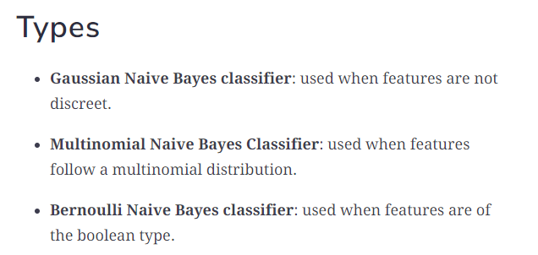

Slide 10
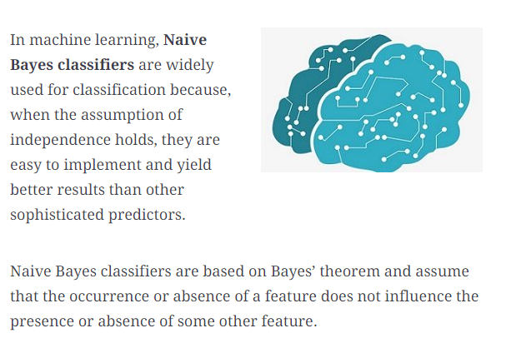

Slide 11
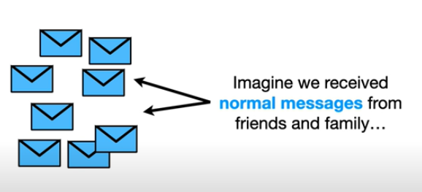
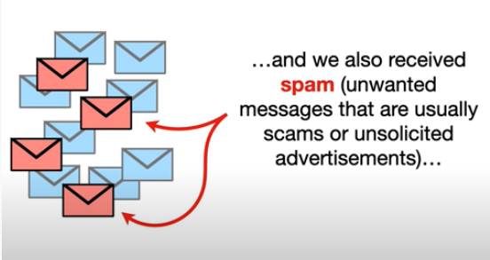

Slide 12
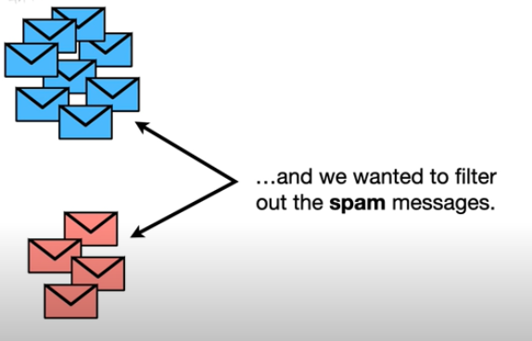

Slide 13
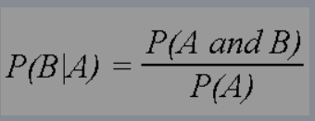
Conditional probability

Slide 14
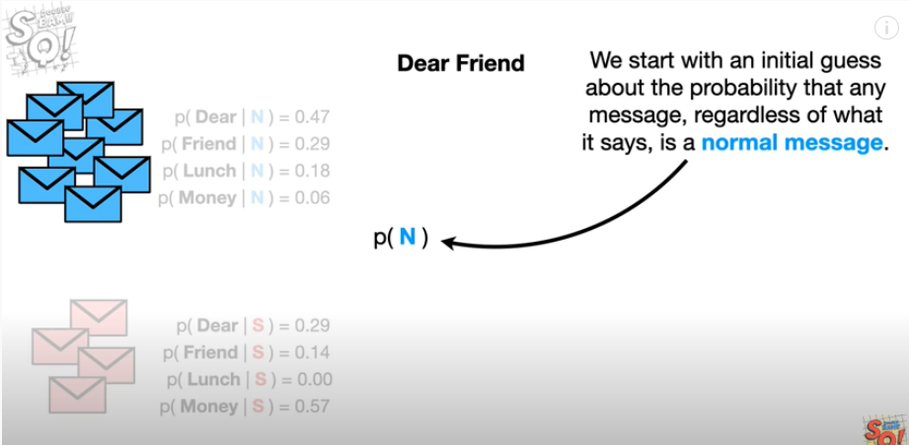

Slide 15
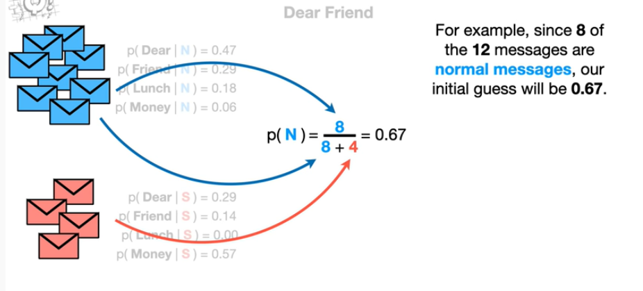

Slide 16
Code
from sklearn.datasets import load_iris from sklearn.model_selection import train_test_split from sklearn.naive_bayes import GaussianNB
X, y = load_iris(return_X_y=True) X_train, X_test, y_train, y_test = train_test_split(X, y, test_size=0.5, random_state=0)
gnb = GaussianNB() y_pred = gnb.fit(X_train, y_train).predict(X_test)
print("Number of mislabeled points out of a total %d points : %d" % (X_test.shape[0], (y_test != y_pred).sum()))

Slide 17
Applications:
Real time Prediction: Naive Bayes is an eager learning classifier and it is sure fast. Thus, it could be used for making predictions in real time.
Multi class Prediction: This algorithm is also well known for multi class prediction feature. Here we can predict the probability of multiple classes of target variable.
Text classification/ Spam Filtering/ Sentiment Analysis: Naive Bayes classifiers mostly used in text classification (due to better result in multi class problems and independence rule) have higher success rate as compared to other algorithms. As a result, it is widely used in Spam filtering (identify spam e-mail) and Sentiment Analysis (in social media analysis, to identify positive and negative customer sentiments)
Recommendation System: Naive Bayes Classifier and Collaborative Filtering together builds a Recommendation System that uses machine learning and data mining techniques to filter unseen information and predict whether a user would like a given resource or not

